Slide 1
Chapter 6 Interfacing

Slide 2
Outline
Interfacing basics
Microprocessor interfacing
  I/O Addressing
  Interrupts
  Direct memory access
Arbitration
Hierarchical buses
Protocols
  Serial
  Parallel
  Wireless

Slide 3
Introduction
Embedded system functionality aspects
  Processing
    Transformation of data
    Implemented using processors
  Storage
    Retention of data
    Implemented using memory
  Communication
    Transfer of data between processors and memories
    Implemented using buses
    Called interfacing

Slide 4
A simple bus
Wires:
  Uni-directional or bi-directional
  One line may represent multiple wires
Bus
  Set of wires with a single function
    Address bus, data bus
  Or, entire collection of wires
    Address, data and control
    Associated protocol: rules for communication
rd'/wr
Processor
Memory
enable
addr[0-11]
data[0-7]
bus
bus structure

Slide 5
Ports
Processor
rd'/wr
Memory
port
enable
addr[0-11]
data[0-7]
bus
Conducting device on periphery
Connects bus to processor or memory
Often referred to as a pin
  Actual pins on periphery of IC package that plug into socket on printed-circuit board
  Sometimes metallic balls instead of pins
  Today, metal “pads” connecting processors and memories within single IC
Single wire or set of wires with single function
  E.g., 12-wire address port

Slide 6
Timing Diagrams
Most common method for describing a communication protocol
Time proceeds to the right on x-axis
Control signal: low or high
  May be active low (e.g., go’, /go, or go_L)
  Use terms assert (active) and deassert
  Asserting go’ means go=0
Data signal: not valid or valid
Protocol may have subprotocols
  Called bus cycle, e.g., read and write
  Each may be several clock cycles
Read example
  rd’/wr set low,address placed on addr for at least t_{setup} time before enable asserted, enable triggers memory to place data on data wires by time t_{read}
rd'/wr
enable
addr
data
t_{setup}
t_{read}
read protocol
rd'/wr
enable
addr
data
t_{setup}
t_{write}
write protocol

Slide 7
Basic protocol concepts
Actor: master initiates, servant (slave) respond
Direction: sender, receiver
Addresses: special kind of data
  Specifies a location in memory, a peripheral, or a register within a peripheral
Time multiplexing
  Share a single set of wires for multiple pieces of data
  Saves wires at expense of time
Time-multiplexed data transfer
Master
req
Servant
Master
req
Servant
data(15:0)
data(15:0)
addr
data
addr
data
mux
data(8)
demux
mux
addr/data
demux
req
req
data
15:8
7:0
addr/data
addr
data
data serializing
address/data muxing

Slide 8
Basic protocol concepts: control methods
Master
req
Servant
Master
req
Servant
ack
data
data
req
1
3
req
1
3
data
2
4
ack
2
4
data
t_{access}
1. Master asserts req to receive data
1. Master asserts req to receive data
2. Servant puts data on bus within time t_{access}
2. Servant puts data on bus and asserts ack
3. Master receives data and deasserts req
3. Master receives data and deasserts req
4. Servant ready for next request
4. Servant ready for next request
Strobe protocol
Handshake protocol

Slide 9
A strobe/handshake compromise
Master
req
Servant
wait
data
req
1
3
req
1
4
wait
wait
2
3
data
2
4
data
5
t_{access}
t_{access}
1. Master asserts req to receive data
1. Master asserts req to receive data
2. Servant puts data on bus within time t_{access}
2. Servant can't put data within t_{access}, asserts wait ack
(wait line is unused)
3. Servant puts data on bus and deasserts wait
3. Master receives data and deasserts req
4. Master receives data and deasserts req
4. Servant ready for next request
5. Servant ready for next request
Fast-response case
Slow-response case

Slide 10
ISA bus protocol – memory access
ISA: Industry Standard Architecture
  Common in 80x86’s
Features
  20-bit address
  Compromise strobe/handshake control
    4 cycles default
    Unless CHRDY deasserted – resulting in additional wait cycles (up to 6)
Microprocessor
Memory
I/O Device
ISA bus
memory-read bus cycle
CYCLE
CLOCK
D[7-0]
A[19-0]
ALE
/MEMR
CHRDY
C1 C2 WAIT C3 C4
DATA
ADDRESS
memory-write bus cycle
CYCLE
CLOCK
D[7-0]
A[19-0]
ALE
/MEMW
CHRDY
C1 C2 WAIT C3 C4
DATA
ADDRESS

Slide 11
Microprocessor interfacing: I/O addressing
A microprocessor communicates with other devices using some of its pins
  Port-based I/O (parallel I/O)
    Processor has one or more N-bit ports
    Processor’s software reads and writes a port just like a register
    E.g., P0 = 0xFF; v = P1.2; -- P0 and P1 are 8-bit ports
  Bus-based I/O
    Processor has address, data and control ports that form a single bus
    Communication protocol is built into the processor
    A single instruction carries out the read or write protocol on the bus

Slide 12
Compromises/extensions
Parallel I/O peripheral
  When processor only supports bus-based I/O but parallel I/O needed
  Each port on peripheral connected to a register within peripheral that is read/written by the processor
Extended parallel I/O
  When processor supports port-based I/O but more ports needed
  One or more processor ports interface with parallel I/O peripheral extending total number of ports available for I/O
  e.g., extending 4 ports to 6 ports in figure
Processor
Memory
System bus
Parallel I/O peripheral
Port A
Port B
Port C
Adding parallel I/O to a bus-based I/O processor
Processor
Port 0
Port 1
Port 2
Port 3
Parallel I/O peripheral
Port A
Port B
Port C
Extended parallel I/O

Slide 13
Types of bus-based I/O: memory-mapped I/O and standard I/O
Processor talks to both memory and peripherals using same bus – two ways to talk to peripherals
  Memory-mapped I/O
    Peripheral registers occupy addresses in same address space as memory
    e.g., Bus has 16-bit address
      lower 32K addresses may correspond to memory
      upper 32k addresses may correspond to peripherals
  Standard I/O (I/O-mapped I/O)
    Additional pin (M/IO) on bus indicates whether a memory or peripheral access
    e.g., Bus has 16-bit address
      all 64K addresses correspond to memory when M/IO set to 0
      all 64K addresses correspond to peripherals when M/IO set to 1

Slide 14
Memory-mapped I/O vs. Standard I/O
Memory-mapped I/O
  Requires no special instructions
    Assembly instructions involving memory like MOV and ADD work with peripherals as well
    Standard I/O requires special instructions (e.g., IN, OUT) to move data between peripheral registers and memory
Standard I/O
  No loss of memory addresses to peripherals
  Simpler address decoding logic in peripherals possible
    When number of peripherals much smaller than address space then high-order address bits can be ignored
      smaller and/or faster comparators

Slide 15
ISA bus
ISA supports standard I/O
  /IOR distinct from /MEMR for peripheral read
    /IOW used for writes
  16-bit address space for I/O vs. 20-bit address space for memory
  Otherwise very similar to memory protocol
ISA I/O bus read protocol
CYCLE
CLOCK
D[7-0]
A[15-0]
ALE
/IOR
CHRDY
C1 C2 WAIT C3 C4
DATA
ADDRESS

Slide 16
A basic memory protocol
8051
74373
HM6264
P0
P2
Q
ALE
/RD
Adr. 7..0
Data
P0
D
Q
D<0...7>
/CS
A<0...15>
Adr. 15…8
ALE
G
/OE
/WE
Adr. 7…0
8
CS2
/CS1
P2
/WR
27C256
/RD
/CS
/PSEN
D<0...7>
A<0...14>
/OE
Interfacing an 8051 to external memory
  Ports P0 and P2 support port-based I/O when 8051 internal memory being used
  Those ports serve as data/address buses when external memory is being used
  16-bit address and 8-bit data are time multiplexed; low 8-bits of address must therefore be latched with aid of ALE signal

Slide 17
A more complex memory protocol
FSM description
Specification for a single read operation
GO=0
ADSP=1,
ADSC=1
ADV=1, OE=1, Addr = ‘Z’
GO=1
ADSP=0,
ADSC=0
ADV=0, OE=1, Addr = Addr0
CLK
/ADSP
/ADSC
/ADV
addr <15…0>
/WE
/OE
/CS1 and /CS2
CS3
data<31…0>
S0
S1
GO=0
Data is ready here!
GO=0
GO=1
ADSP=1,
ADSC=0
ADV=1, OE=1, Addr = ‘Z’
ADSP=1,
ADSC=1
ADV=0, OE=0, Addr = ‘Z’
S2
S3
GO=1
GO=1
GO=0
Generates control signals to drive the TC55V2325FF memory chip in burst mode
  Addr0 is the starting address input to device
  GO is enable/disable input to device

Slide 18
Microprocessor interfacing: interrupts
Suppose a peripheral intermittently receives data, which must be serviced by the processor
  The processor can poll the peripheral regularly to see if data has arrived – wasteful
  The peripheral can interrupt the processor when it has data
Requires an extra pin or pins: Int
  If Int is 1, processor suspends current program, jumps to an Interrupt Service Routine, or ISR
  Known as interrupt-driven I/O
  Essentially, “polling” of the interrupt pin is built-into the hardware, so no extra time!

Slide 19
Microprocessor interfacing: interrupts
What is the address (interrupt address vector) of the ISR?
  Fixed interrupt
    Address built into microprocessor, cannot be changed
    Either ISR stored at address or a jump to actual ISR stored if not enough bytes available
  Vectored interrupt
    Peripheral must provide the address
    Common when microprocessor has multiple peripherals connected by a system bus
  Compromise: interrupt address table

Slide 20
Interrupt-driven I/O using fixed ISR location
Time
1(a): μP is executing its main program.
1(b): P1 receives input data in a register with address 0x8000.
2: P1 asserts Int to request servicing by the microprocessor.
3: After completing instruction at 100, μP sees Int asserted, saves the PC’s value of 100, and sets PC to the ISR fixed location of 16.
4(a): The ISR reads data from 0x8000, modifies the data, and writes the resulting data to 0x8001.
4(b): After being read, P1 de-asserts Int.
5: The ISR returns, thus restoring PC to 100+1=101, where μP resumes executing.

Slide 21
Interrupt-driven I/O using fixed ISR location
1(a): μP is executing its main program
1(b): P1 receives input data in a register with address 0x8000.
Program memory
μP
Data memory
ISR
16:
MOV R0, 0x8000
System bus
17:
# modifies R0
18:
MOV 0x8001, R0
19:
RETI # ISR return
...
Int
P1
P2
Main program
...
PC
0x8000
0x8001
100:
instruction
101:
instruction

Slide 22
Interrupt-driven I/O using fixed ISR location
2: P1 asserts Int to request servicing by the microprocessor
Program memory
μP
Data memory
ISR
16:
MOV R0, 0x8000
System bus
17:
# modifies R0
18:
MOV 0x8001, R0
19:
RETI # ISR return
...
Int
P1
P2
Int
Main program
1
...
PC
0x8000
0x8001
100:
instruction
101:
instruction

Slide 23
Interrupt-driven I/O using fixed ISR location
3: After completing instruction at 100, μP sees Int asserted, saves the PC’s value of 100, and sets PC to the ISR fixed location of 16.
Program memory
μP
Data memory
ISR
16:
MOV R0, 0x8000
System bus
17:
# modifies R0
18:
MOV 0x8001, R0
19:
RETI # ISR return
...
Int
P1
P2
Main program
...
PC
0x8000
0x8001
100:
instruction
100
101:
instruction
100

Slide 24
Interrupt-driven I/O using fixed ISR location
4(a): The ISR reads data from 0x8000, modifies the data, and writes the resulting data to 0x8001.
4(b): After being read, P1 deasserts Int.
Program memory
μP
Data memory
ISR
16:
MOV R0, 0x8000
System bus
17:
# modifies R0
System bus
18:
MOV 0x8001, R0
19:
RETI # ISR return
...
P1
P1
P1
P2
Int
P2
Int
Main program
0
...
PC
0x8000
0x8000
0x8001
100:
instruction
0x8001
101:
instruction
100

Slide 25
Interrupt-driven I/O using fixed ISR location
5: The ISR returns, thus restoring PC to 100+1=101, where μP resumes executing.
Program memory
μP
Data memory
ISR
ISR
16:
MOV R0, 0x8000
16:
MOV R0, 0x8000
System bus
17:
17:
# modifies R0
# modifies R0
18:
18:
MOV 0x8001, R0
MOV 0x8001, R0
19:
19:
RETI # ISR return
...
RETI # ISR return
...
Int
P1
P2
Main program
Main program
...
...
PC
0x8000
0x8001
100:
instruction
100:
instruction
+1
100
100
101:
instruction
100
101:
instruction

Slide 26
Interrupt-driven I/O using vectored interrupt
1(a): μP is executing its main program.
1(b): P1 receives input data in a register with address 0x8000.
Time
2: P1 asserts Int to request servicing by the microprocessor.
3: After completing instruction at 100, μP sees Int asserted, saves the PC’s value of 100, and asserts Inta.
4: P1 detects Inta and puts interrupt address vector 16 on the data bus.
5(a): μP jumps to the address on the bus (16). The ISR there reads data from 0x8000, modifies the data, and writes the resulting data to 0x8001.
5(b): After being read, P1 deasserts Int.
6: The ISR returns, thus restoring PC to 100+1=101, where μP resumes executing.

Slide 27
Interrupt-driven I/O using vectored interrupt
1(a): P is executing its main program
1(b): P1 receives input data in a register with address 0x8000.
Program memory
μP
Data memory
ISR
16:
MOV R0, 0x8000
System bus
17:
# modifies R0
18:
MOV 0x8001, R0
19:
RETI # ISR return
...
Inta
P1
P2
Main program
Int
...
PC
16
100:
instruction
0x8000
0x8001
101:
instruction
100

Slide 28
Interrupt-driven I/O using vectored interrupt
2: P1 asserts Int to request servicing by the microprocessor
Program memory
μP
Data memory
ISR
16:
MOV R0, 0x8000
System bus
17:
# modifies R0
18:
MOV 0x8001, R0
19:
RETI # ISR return
...
Inta
P1
P2
Int
Main program
Int
...
PC
1
16
100:
instruction
0x8000
0x8001
101:
instruction
100

Slide 29
Interrupt-driven I/O using vectored interrupt
3: After completing instruction at 100, μP sees Int asserted, saves the PC’s value of 100, and asserts Inta
Program memory
μP
Data memory
ISR
16:
MOV R0, 0x8000
System bus
17:
# modifies R0
18:
MOV 0x8001, R0
19:
RETI # ISR return
1
...
Inta
Inta
P1
P2
Main program
Int
...
PC
16
100:
instruction
0x8000
0x8001
100
101:
instruction
100

Slide 30
Interrupt-driven I/O using vectored interrupt
4: P1 detects Inta and puts interrupt address vector 16 on the data bus
Program memory
μP
Data memory
ISR
16:
MOV R0, 0x8000
System bus
17:
# modifies R0
16
System bus
18:
MOV 0x8001, R0
19:
RETI # ISR return
...
Inta
P1
P2
Main program
Int
16
...
PC
16
100:
instruction
0x8000
0x8001
101:
instruction
100

Slide 31
Interrupt-driven I/O using vectored interrupt
5(a): PC jumps to the address on the bus (16). The ISR there reads data from 0x8000, modifies the data, and writes the resulting data to 0x8001.
5(b): After being read, P1 deasserts Int.
Program memory
μP
Data memory
ISR
ISR
16:
MOV R0, 0x8000
16:
MOV R0, 0x8000
System bus
17:
# modifies R0
System bus
17:
# modifies R0
18:
18:
MOV 0x8001, R0
MOV 0x8001, R0
19:
19:
RETI # ISR return
...
RETI # ISR return
...
Inta
P1
P1
P2
Int
P2
Main program
Int
Main program
16
...
...
PC
0
100:
instruction
100:
instruction
0x8000
0x8000
0x8001
100
0x8001
101:
101:
instruction
instruction

Slide 32
Interrupt-driven I/O using vectored interrupt
6: The ISR returns, thus restoring the PC to 100+1=101, where the μP resumes
Program memory
μP
Data memory
ISR
ISR
16:
MOV R0, 0x8000
16:
MOV R0, 0x8000
System bus
17:
17:
# modifies R0
# modifies R0
18:
18:
MOV 0x8001, R0
MOV 0x8001, R0
19:
19:
RETI # ISR return
...
RETI # ISR return
...
Int
P1
P2
Main program
Main program
...
...
PC
0x8000
0x8001
100:
instruction
100:
instruction
+1
100
100
101:
instruction
100
101:
instruction

Slide 33
Interrupt address table
Compromise between fixed and vectored interrupts
  One interrupt pin
  Table in memory holding ISR addresses (maybe 256 words)
  Peripheral doesn’t provide ISR address, but rather index into table
    Fewer bits are sent by the peripheral
    Can move ISR location without changing peripheral

Slide 34
Additional interrupt issues
Maskable vs. non-maskable interrupts
  Maskable: programmer can set bit that causes processor to ignore interrupt
    Important when in the middle of time-critical code
  Non-maskable: a separate interrupt pin that can’t be masked
    Typically reserved for drastic situations, like power failure requiring immediate backup of data to non-volatile memory
Jump to ISR
  Some microprocessors treat jump same as call of any subroutine
    Complete state saved (PC, registers) – may take hundreds of cycles
  Others only save partial state, like PC only
    Thus, ISR must not modify registers, or else must save them first
    Assembly-language programmer must be aware of which registers stored

Slide 35
Direct memory access
Buffering
  Temporarily storing data in memory before processing
  Data accumulated in peripherals commonly buffered
Microprocessor could handle this with ISR
  Storing and restoring microprocessor state inefficient
  Regular program must wait
DMA controller more efficient
  Separate single-purpose processor
  Microprocessor relinquishes control of system bus to DMA controller
  Microprocessor can meanwhile execute its regular program
    No inefficient storing and restoring state due to ISR call
    Regular program need not wait unless it requires the system bus
      Harvard archictecture – processor can fetch and execute instructions as long as they don’t access data memory – if they do, processor stalls

Slide 36
Peripheral to memory transfer without DMA, using vectored interrupt
Time
1(a): μP is executing its main program.
1(b): P1 receives input data in a register with address 0x8000.
2: P1 asserts Int to request servicing by the microprocessor.
3: After completing instruction at 100, μP sees Int asserted, saves the PC’s value of 100, and asserts Inta.
4: P1 detects Inta and puts interrupt address vector 16 on the data bus.
5(a): μP jumps to the address on the bus (16). The ISR there reads data from 0x8000 and then writes it to 0x0001, which is in memory.
5(b): After being read, P1 deasserts Int.
6: The ISR returns, thus restoring PC to 100+1=101, where μP resumes executing.

Slide 37
Peripheral to memory transfer without DMA, using vectored interrupt
1(a): μP is executing its main program
1(b): P1 receives input data in a register with address 0x8000.
Program memory
μP
Data memory
ISR
0x0000
0x0001
16:
MOV R0, 0x8000
17:
# modifies R0
18:
MOV 0x0001, R0
System bus
19:
RETI # ISR return
...
Main program
Inta
P1
...
Int
100:
instruction
16
101:
instruction
PC
0x8000

Slide 38
Peripheral to memory transfer without DMA, using vectored interrupt
2: P1 asserts Int to request servicing by the microprocessor
Program memory
μP
Data memory
ISR
0x0000
0x0001
16:
MOV R0, 0x8000
17:
# modifies R0
18:
MOV 0x0001, R0
System bus
19:
RETI # ISR return
...
Main program
Inta
P1
...
Int
100:
instruction
Int
16
101:
instruction
PC
1
0x8000
100

Slide 39
Peripheral to memory transfer without DMA, using vectored interrupt
3: After completing instruction at 100, μP sees Int asserted, saves the PC’s value of 100, and asserts Inta.
Program memory
μP
Data memory
ISR
0x0000
0x0001
16:
MOV R0, 0x8000
17:
# modifies R0
18:
MOV 0x0001, R0
System bus
19:
RETI # ISR return
...
1
Inta
Main program
Inta
P1
...
Int
100:
instruction
16
101:
instruction
PC
0x8000
100
100

Slide 40
Peripheral to memory transfer without DMA, using vectored interrupt (cont’)
4: P1 detects Inta and puts interrupt address vector 16 on the data bus.
Program memory
μP
Data memory
ISR
0x0000
0x0001
16:
MOV R0, 0x8000
17:
# modifies R0
System bus
18:
MOV 0x0001, R0
16
System bus
19:
RETI # ISR return
...
Main program
Inta
P1
...
Int
16
100:
instruction
16
101:
instruction
PC
0x8000
100

Slide 41
Peripheral to memory transfer without DMA, using vectored interrupt (cont’)
5(a): μP jumps to the address on the bus (16). The ISR there reads data from 0x8000 and then writes it to 0x0001, which is in memory.
5(b): After being read, P1 de-asserts Int.
μP
Data memory
Program memory
Data memory
0x0000
0x0001
ISR
0x0001
ISR
ISR
16:
16:
16:
MOV R0, 0x8000
MOV R0, 0x8000
MOV R0, 0x8000
17:
17:
17:
# modifies R0
# modifies R0
# modifies R0
System bus
18:
System bus
18:
18:
MOV 0x8001, R0
MOV 0x8001, R0
MOV 0x0001, R0
19:
19:
19:
RETI # ISR return
RETI # ISR return
...
RETI # ISR return
...
...
Main program
Inta
Main program
Main program
P1
...
P1
...
...
Int
100:
Int
16
100:
100:
instruction
instruction
instruction
PC
0
101:
101:
101:
instruction
instruction
instruction
0x8000
0x8000
100

Slide 42
Peripheral to memory transfer without DMA, using vectored interrupt (cont’)
6: The ISR returns, thus restoring PC to 100+1=101, where μP resumes executing.
Program memory
μP
Data memory
ISR
0x0000
0x0001
ISR
16:
16:
MOV R0, 0x8000
MOV R0, 0x8000
17:
17:
# modifies R0
# modifies R0
18:
System bus
18:
MOV 0x8001, R0
MOV 0x0001, R0
19:
19:
RETI # ISR return
...
RETI # ISR return
...
Main program
Inta
Main program
P1
...
...
Int
100:
16
100:
instruction
instruction
PC
101:
101:
instruction
instruction
+1
0x8000
100
100

Slide 43
Peripheral to memory transfer with DMA
1(a): μP is executing its main program. It has already configured the DMA ctrl registers.
1(b): P1 receives input data in a register with address 0x8000.
Time
4: After executing instruction 100, μP sees Dreq asserted, releases the system bus, asserts Dack, and resumes execution. μP stalls only if it needs the system bus to continue executing.
3: DMA ctrl asserts Dreq to request control of system bus.
2: P1 asserts req to request servicing by DMA ctrl.
5: (a) DMA ctrl asserts ack (b) reads data from 0x8000 and (b) writes that data to 0x0001.
6:. DMA de-asserts Dreq and ack completing handshake with P1.
7(a): μP de-asserts Dack and resumes control of the bus.
7(b): P1 de-asserts req.

Slide 44
Peripheral to memory transfer with DMA (cont’)
1(a): μP is executing its main program. It has already configured the DMA ctrl registers
1(b): P1 receives input data in a register with address 0x8000.
Program memory
μP
Data memory
0x0000
0x0001
No ISR needed!
System bus
...
Dack
DMA ctrl
P1
Main program
Dreq
...
0x0001
ack
100:
instruction
PC
0x8000
req
101:
instruction
0x8000
100

Slide 45
Peripheral to memory transfer with DMA (cont’)
2: P1 asserts req to request servicing
by DMA ctrl.
3: DMA ctrl asserts Dreq to request control of system bus
Program memory
μP
Data memory
0x0000
0x0001
No ISR needed!
System bus
...
Dack
DMA ctrl
DMA ctrl
P1
P1
Main program
Dreq
P1
...
Dreq
0x0001
ack
100:
instruction
1
PC
req
101:
instruction
0x8000
req
0x8000
100
1

Slide 46
Peripheral to memory transfer with DMA (cont’)
4: After executing instruction 100, μP sees Dreq asserted, releases the system bus, asserts Dack, and resumes execution, μP stalls only if it needs the system bus to continue executing.
Program memory
μP
Data memory
0x0000
0x0001
No ISR needed!
System bus
...
Dack
1
Main program
Dack
DMA ctrl
P1
...
Dreq
0x0001
ack
100:
instruction
PC
0x8000
req
101:
instruction
0x8000
100

Slide 47
Peripheral to memory transfer with DMA (cont’)
5: DMA ctrl (a) asserts ack, (b) reads data from 0x8000, and (c) writes that data to 0x0001.
(Meanwhile, processor still executing if not stalled!)
μP
Data memory
Program memory
Data memory
0x0000
0x0001
0x0000
0x0001
No ISR needed!
System bus
System bus
...
Dack
DMA ctrl
P1
Main program
Dreq
DMA ctrl
1
P1
...
ack
ack
0x0001
ack
0x0001
100:
instruction
PC
req
0x8000
req
0x8000
0x8000
101:
instruction
0x8000
100

Slide 48
Peripheral to memory transfer with DMA (cont’)
6: DMA de-asserts Dreq and ack completing the handshake with P1.
Program memory
μP
Data memory
0x0000
0x0001
No ISR needed!
System bus
...
Dack
DMA ctrl
P1
Main program
Dreq
0
...
Dreq
ack
0
0x0001
ack
100:
instruction
PC
0x8000
req
101:
instruction
0x8000
100

Slide 49
ISA bus DMA cycles
Processor
Memory
ISA-Bus
R
A
R
DMA
A
I/O Device
DMA Memory-Write Bus Cycle
DMA Memory-Read Bus Cycle
CYCLE
CLOCK
D[7-0]
A[19-0]
ALE
/IOR
/MEMW
CHRDY
C1 C2 C3 C4 C5 C6 C7
CYCLE
CLOCK
D[7-0]
A[19-0]
ALE
/MEMR
/IOW
CHRDY
C1 C2 C3 C4 C5 C6 C7
DATA
DATA
ADDRESS
ADDRESS

Slide 50
Arbitration: Priority arbiter
Consider the situation where multiple peripherals request service from single resource (e.g., microprocessor, DMA controller) simultaneously - which gets serviced first?
Priority arbiter
  Single-purpose processor
  Peripherals make requests to arbiter, arbiter makes requests to resource
  Arbiter connected to system bus for configuration only
Micro-processor
System bus
7
Inta
5
Priority
arbiter
Peripheral1
Peripheral2
Int
3
Ireq1
2
2
Iack1
6
Ireq2
Iack2

Slide 51
Arbitration using a priority arbiter
Micro-processor
System bus
7
Inta
5
Priority
arbiter
Peripheral1
Peripheral2
Int
3
Ireq1
2
2
Iack1
6
Ireq2
Iack2
1. Microprocessor is executing its program.
2. Peripheral1 needs servicing so asserts Ireq1. Peripheral2 also needs servicing so asserts Ireq2.
3. Priority arbiter sees at least one Ireq input asserted, so asserts Int.
4. Microprocessor stops executing its program and stores its state.
5. Microprocessor asserts Inta.
6. Priority arbiter asserts Iack1 to acknowledge Peripheral1.
7. Peripheral1 puts its interrupt address vector on the system bus
8. Microprocessor jumps to the address of ISR read from data bus, ISR executes and returns
(and completes handshake with arbiter).
9. Microprocessor resumes executing its program.

Slide 52
Arbitration: Priority arbiter
Types of priority
    Fixed priority
      each peripheral has unique rank
      highest rank chosen first with simultaneous requests
      preferred when clear difference in rank between peripherals
    Rotating priority (round-robin)
      priority changed based on history of servicing
      better distribution of servicing especially among peripherals with similar priority demands

Slide 53
Arbitration: Daisy-chain arbitration
Arbitration done by peripherals
  Built into peripheral or external logic added
    req input and ack output added to each peripheral
Peripherals connected to each other in daisy-chain manner
  One peripheral connected to resource, all others connected “upstream”
  Peripheral’s req flows “downstream” to resource, resource’s ack flows “upstream” to requesting peripheral
  Closest peripheral has highest priority
μP
System bus
Peripheral1
Peripheral2
Inta
Ack_in
Ack_out
Ack_in
Ack_out
Int
Req_out
Req_in
Req_out
Req_in
0
Daisy-chain aware peripherals

Slide 54
Arbitration: Daisy-chain arbitration
Pros/cons
  Easy to add/remove peripheral - no system redesign needed
  Does not support rotating priority
  One broken peripheral can cause loss of access to other peripherals
Micro-processor
μP
System bus
System bus
Inta
Priority
arbiter
Peripheral1
Peripheral2
Int
Peripheral1
Peripheral2
Inta
Ack_in
Ack_out
Ack_in
Ack_out
Ireq1
Int
Req_out
Req_in
Req_out
Req_in
0
Iack1
Ireq2
Iack2
Daisy-chain aware peripherals

Slide 55
Network-oriented arbitration
When multiple microprocessors share a bus (sometimes called a network)
  Arbitration typically built into bus protocol
  Separate processors may try to write simultaneously causing collisions
    Data must be resent
    Don’t want to start sending again at same time
      statistical methods can be used to reduce chances
Typically used for connecting multiple distant chips
  Trend – use to connect multiple on-chip processors

Slide 56
Example: Vectored interrupt using an interrupt table
Processor
Fixed priority: i.e., Peripheral1 has highest priority
Keyword “_at_” followed by memory address forces compiler to place variables in specific memory locations
  e.g., memory-mapped registers in arbiter, peripherals
A peripheral’s index into interrupt table is sent to memory-mapped register in arbiter
Peripherals receive external data and raise interrupt
MASK
IDX0
IDX1
ENABLE
DATA
MEMORY
Priority Arbiter
Memory Bus
Peripheral 1
Peripheral 2
Jump Table
void Peripheral1_ISR(void) {
unsigned char data;
data = PERIPHERAL1_DATA_REG;
}
// do something with the data
unsigned char ARBITER_MASK_REG _at_ 0xfff0;
unsigned char ARBITER_CH0_INDEX_REG _at_ 0xfff1;
unsigned char ARBITER_CH1_INDEX_REG _at_ 0xfff2;
unsigned char ARBITER_ENABLE_REG _at_ 0xfff3;
unsigned char PERIPHERAL1_DATA_REG _at_ 0xffe0;
unsigned char PERIPHERAL2_DATA_REG _at_ 0xffe1;
unsigned void* INTERRUPT_LOOKUP_TABLE[256] _at_ 0x0100;
void Peripheral2_ISR(void) {
unsigned char data;
data = PERIPHERAL2_DATA_REG;
}
// do something with the data
void InitializePeripherals(void) {
ARBITER_MASK_REG = 0x03;
// enable both channels
ARBITER_CH0_INDEX_REG = 13;
ARBITER_CH1_INDEX_REG = 17;
void main() {
INTERRUPT_LOOKUP_TABLE[13] = (void*)Peripheral1_ISR;
InitializePeripherals();
INTERRUPT_LOOKUP_TABLE[17] = (void*)Peripheral2_ISR;
for(;;) {} // main program goes here
}
ARBITER_ENABLE_REG = 1;
}

Slide 57
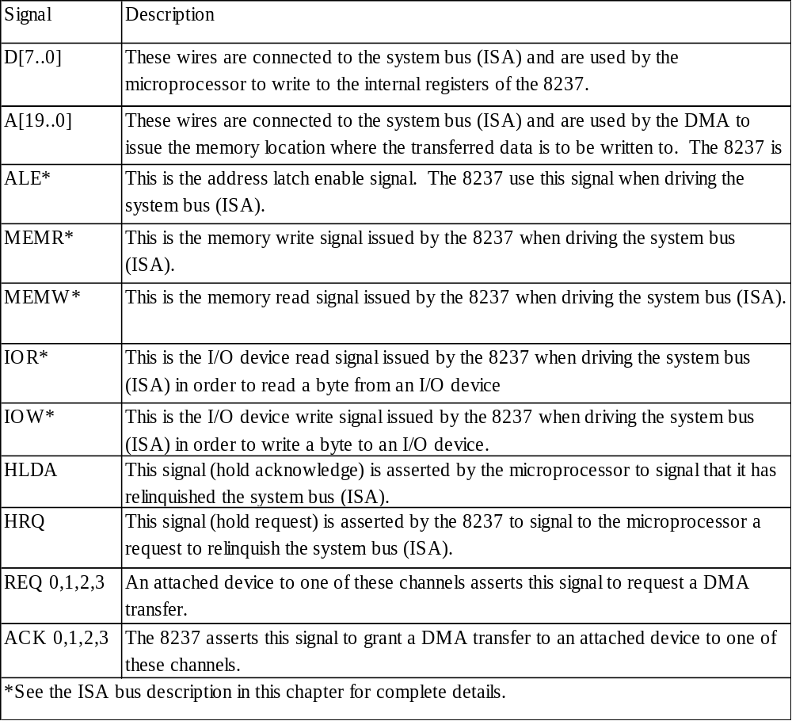
Intel 8237 DMA controller
D[7..0]
A[19..0]
ALE
MEMR
MEMW
IOR
IOW
HLDA
HRQ
Intel 8237
REQ 0
ACK 0
REQ 1
ACK 1
REQ 2
ACK 2
REQ 3
ACK 3

Slide 58
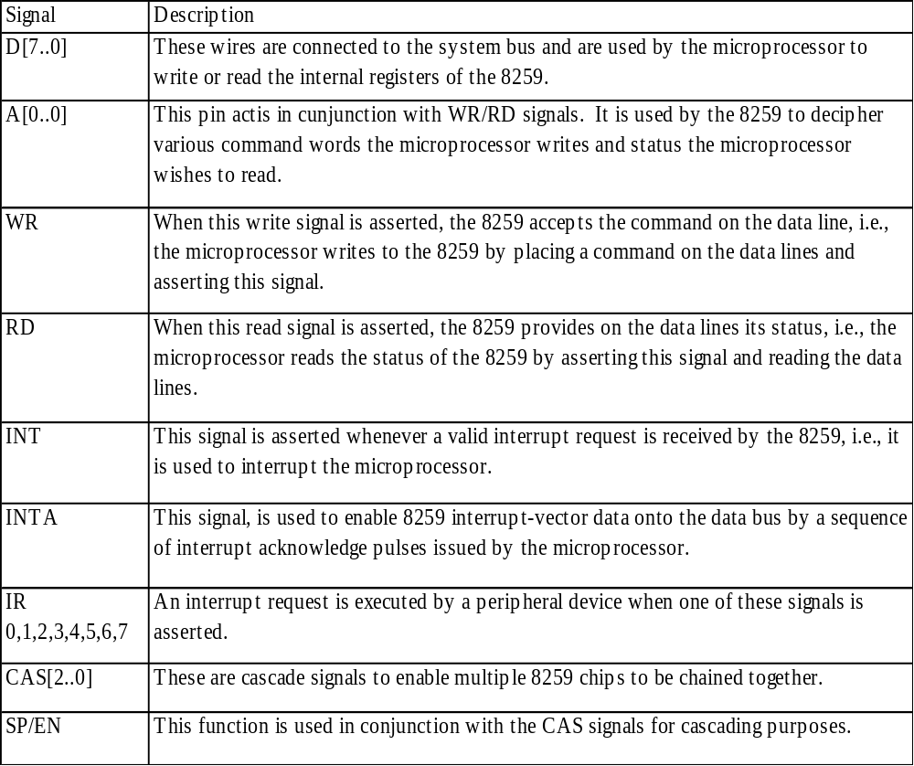
Intel 8259 programmable priority controller
D[7..0]
A[0..0]
RD
WR
INT
INTA
CAS[2..0]
SP/EN
Intel 8259
IR0
IR1
IR2
IR3
IR4
IR5
IR6
IR7

Slide 59
Multilevel bus architectures
Don’t want one bus for all communication
  Peripherals would need high-speed, processor-specific bus interface
    excess gates, power consumption, and cost; less portable
  Too many peripherals slows down bus
Processor-local bus
  High speed, wide, most frequent communication
  Connects microprocessor, cache, memory controllers, etc.
Peripheral bus
  Lower speed, narrower, less frequent communication
  Typically industry standard bus (ISA, PCI) for portability
Micro-
processor
Cache
Memory
controller
DMA
controller
Processor-local bus
Peripheral
Peripheral
Peripheral
Bridge
Peripheral bus
Bridge
  Single-purpose processor converts communication between busses

Slide 60
Advanced communication principles
Layering
  Break complexity of communication protocol into pieces easier to design and understand
  Lower levels provide services to higher level
    Lower level might work with bits while higher level might work with packets of data
  Physical layer
    Lowest level in hierarchy
    Medium to carry data from one actor (device or node) to another
Parallel communication
  Physical layer capable of transporting multiple bits of data
Serial communication
  Physical layer transports one bit of data at a time
Wireless communication
  No physical connection needed for transport at physical layer

Slide 61
Parallel communication
Multiple data, control, and possibly power wires
  One bit per wire
High data throughput with short distances
Typically used when connecting devices on same IC or same circuit board
  Bus must be kept short
    long parallel wires result in high capacitance values which requires more time to charge/discharge
    Data misalignment between wires increases as length increases
Higher cost, bulky

Slide 62
Serial communication
Single data wire, possibly also control and power wires
Words transmitted one bit at a time
Higher data throughput with long distances
  Less average capacitance, so more bits per unit of time
Cheaper, less bulky
More complex interfacing logic and communication protocol
  Sender needs to decompose word into bits
  Receiver needs to recompose bits into word
  Control signals often sent on same wire as data increasing protocol complexity

Slide 63
Wireless communication
Infrared (IR)
  Electronic wave frequencies just below visible light spectrum
  Diode emits infrared light to generate signal
  Infrared transistor detects signal, conducts when exposed to infrared light
  Cheap to build
  Need line of sight, limited range
Radio frequency (RF)
  Electromagnetic wave frequencies in radio spectrum
  Analog circuitry and antenna needed on both sides of transmission
  Line of sight not needed, transmitter power determines range

Slide 64
Error detection and correction
Often part of bus protocol
Error detection: ability of receiver to detect errors during transmission
Error correction: ability of receiver and transmitter to cooperate to correct problem
  Typically done by acknowledgement/retransmission protocol
Bit error: single bit is inverted
Burst of bit error: consecutive bits received incorrectly
Parity: extra bit sent with word used for error detection
  Odd parity: data word plus parity bit contains odd number of 1’s
  Even parity: data word plus parity bit contains even number of 1’s
  Always detects single bit errors, but not all burst bit errors
Checksum: extra word sent with data packet of multiple words
  e.g., extra word contains XOR sum of all data words in packet

Slide 65
Serial protocols: I²C
I²C (Inter-IC)
  Two-wire serial bus protocol developed by Philips Semiconductors nearly 20 years ago
  Enables peripheral ICs to communicate using simple communication hardware
  Data transfer rates up to 100 kbits/s and 7-bit addressing possible in normal mode
  3.4 Mbits/s and 10-bit addressing in fast-mode
  Common devices capable of interfacing to I²C bus:
    EPROMS, Flash, and some RAM memory, real-time clocks, watchdog timers, and microcontrollers

Slide 66
I2C bus structure
SCL
SDA
Micro-controller
(master)
EEPROM
(servant)
Temp. Sensor
(servant)
LCD-controller
(servant)
< 400 pF
Addr=0x01 Addr=0x02 Addr=0x03
SDA
SDA
SDA
SDA
SCL
SCL
SCL
SCL
Start condition
Sending 0
Sending 1
Stop condition
From Servant
From receiver
D
C
ST
ART
A6
A5
A0
R/w
ACK
D8
D7
D0
ACK
ST
OP
Typical read/write cycle

Slide 67
Serial protocols: CAN
CAN (Controller area network)
  Protocol for real-time applications
  Developed by Robert Bosch GmbH
  Originally for communication among components of cars
  Applications now using CAN include:
    elevator controllers, copiers, telescopes, production-line control systems, and medical instruments
  Data transfer rates up to 1 Mbit/s and 11-bit addressing
  Common devices interfacing with CAN:
    8051-compatible 8592 processor and standalone CAN controllers
  Actual physical design of CAN bus not specified in protocol
    Requires devices to transmit/detect dominant and recessive signals to/from bus
    e.g., ‘1’ = dominant, ‘0’ = recessive if single data wire used
    Bus guarantees dominant signal prevails over recessive signal if asserted simultaneously

Slide 68
Serial protocols: FireWire
FireWire (a.k.a. I-Link, Lynx, IEEE 1394)
  High-performance serial bus developed by Apple Computer Inc.
  Designed for interfacing independent electronic components
    e.g., Desktop, scanner
  Data transfer rates from 12.5 to 400 Mbits/s, 64-bit addressing
  Plug-and-play capabilities
  Packet-based layered design structure
  Applications using FireWire include:
    disk drives, printers, scanners, cameras
  Capable of supporting a LAN similar to Ethernet
    64-bit address:
      10 bits for network ids, 1023 subnetworks
      6 bits for node ids, each subnetwork can have 63 nodes
      48 bits for memory address, each node can have 281 terabytes of distinct locations

Slide 69
Serial protocols: USB
USB (Universal Serial Bus)
  Easier connection between PC and monitors, printers, digital speakers, modems, scanners, digital cameras, joysticks, multimedia game equipment
  2 data rates:
    12 Mbps for increased bandwidth devices
    1.5 Mbps for lower-speed devices (joysticks, game pads)
  Tiered star topology can be used
    One USB device (hub) connected to PC
      hub can be embedded in devices like monitor, printer, or keyboard or can be standalone
    Multiple USB devices can be connected to hub
    Up to 127 devices can be connected like this
  USB host controller
    Manages and controls bandwidth and driver software required by each peripheral
    Dynamically allocates power downstream according to devices connected/disconnected

Slide 70
Parallel protocols: PCI Bus
PCI Bus (Peripheral Component Interconnect)
  High performance bus originated at Intel in the early 1990’s
  Standard adopted by industry and administered by PCISIG (PCI Special Interest Group)
  Interconnects chips, expansion boards, processor memory subsystems
  Data transfer rates of 127.2 to 508.6 Mbits/s and 32-bit addressing
    Later extended to 64-bit while maintaining compatibility with 32-bit schemes
  Synchronous bus architecture
  Multiplexed data/address lines

Slide 71
Parallel protocols: ARM Bus
ARM Bus
  Designed and used internally by ARM Corporation
  Interfaces with ARM line of processors
  Many IC design companies have own bus protocol
  Data transfer rate is a function of clock speed
    If clock speed of bus is X, transfer rate = 16 x X bits/s
  32-bit addressing

Slide 72
Wireless protocols: IrDA
IrDA
  Protocol suite that supports short-range point-to-point infrared data transmission
  Created and promoted by the Infrared Data Association (IrDA)
  Data transfer rate of 9.6 kbps and 4 Mbps
  IrDA hardware deployed in notebook computers, printers, PDAs, digital cameras, public phones, cell phones
  Lack of suitable drivers has slowed use by applications
  Windows 2000/98 now include support
  Becoming available on popular embedded OS’s

Slide 73
Wireless protocols: Bluetooth
Bluetooth
  New, global standard for wireless connectivity
  Based on low-cost, short-range radio link
  Connection established when within 10 meters of each other
  No line-of-sight required
    e.g., Connect to printer in another room

Slide 74
Wireless Protocols: IEEE 802.11
IEEE 802.11
  Proposed standard for wireless LANs
  Specifies parameters for PHY and MAC layers of network
    PHY layer
      physical layer
      handles transmission of data between nodes
      provisions for data transfer rates of 1 or 2 Mbps
      operates in 2.4 to 2.4835 GHz frequency band (RF)
      or 300 to 428,000 GHz (IR)
    MAC layer
      medium access control layer
      protocol responsible for maintaining order in shared medium
      collision avoidance/detection

Slide 75
Chapter Summary
Basic protocol concepts
  Actors, direction, time multiplexing, control methods
General-purpose processors
  Port-based or bus-based I/O
  I/O addressing: Memory mapped I/O or Standard I/O
  Interrupt handling: fixed or vectored
  Direct memory access
Arbitration
  Priority arbiter (fixed/rotating) or daisy chain
Bus hierarchy
Advanced communication
  Parallel vs. serial, wires vs. wireless, error detection/correction, layering
  Serial protocols: I²C, CAN, FireWire, and USB; Parallel: PCI and ARM.
  Serial wireless protocols: IrDA, Bluetooth, and IEEE 802.11.

